Slide 1
AI-BASED MULTILINGUAL NEWS
CATEGORIZATION SYSTEM
REVIEW-2 FOCUS
Improve the project by introducing a more project-specific text-analysis approach instead of directly using the main models from the reviewed papers.
Review-2 Project Presentation
Mini Hackathon – 1 | Team 5
Course Coordinator: Dr. K. Swanthana
Course Code: 24ALT3101
Name: G. Surya Roll: 2420090102
Name: Ch. Siddhartha Roll: 2420090015
Name: Y.V. Likhith Roll: 2420090142
Name: K. Rishiwan Roll: 2420030762
Name: R.Sai Sidhardha Roll:2400032486
Applied Machine Learning for Text Analysis | Review-2
1

Slide 2
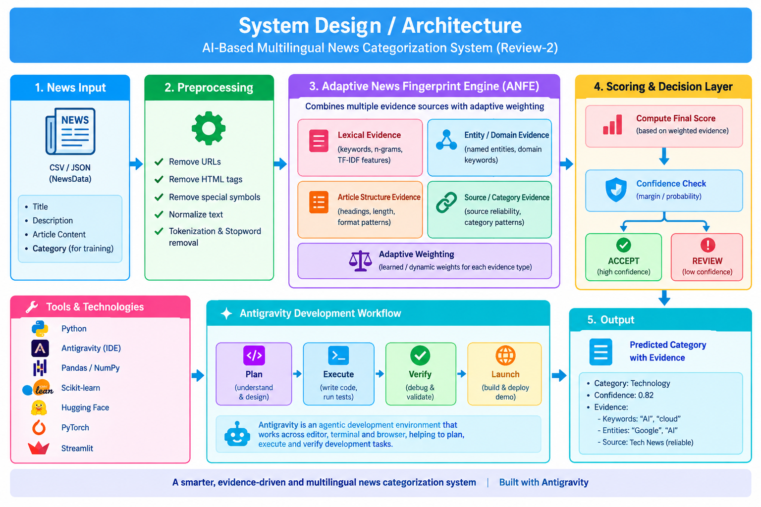

Slide 3
1. Brief Review-1 Context
Only the background needed to understand what is changing in Review-2.
Review-1 Baseline
Why Review-2 Changes
The implemented pipeline used:
TF-IDF → Chi-square feature selection → Linear SVM
On the 289-sample held-out test set:
Accuracy: 80.28%
Weighted F1: 79.80%
The project literature also covered BERT, mBERT, XLM-R and multilingual news datasets.
The mentor feedback is to move beyond simply reusing these established model choices and make the project more distinct.
Review-1 results remain a BASELINE. Review-2 focuses on the new methodology.
Applied Machine Learning for Text Analysis | Review-2
2

Slide 4
2. What Is New in Review-2?
A small but important distinction from the existing research-paper approaches.
Existing Direction
Our Review-2 Direction
Why It Is Different
Traditional text classification
• TF-IDF + SVM
• Transformer-based classification
• Multilingual transformer extension
These are established approaches discussed in the literature.
Adaptive News Fingerprint Engine
• Multiple text signals
• Category-specific fingerprints
• Adaptive evidence weighting
• REVIEW for uncertain predictions
The proposed contribution is the decision workflow itself:
combine interpretable evidence → score categories → measure uncertainty → explain the decision.
It is not presented as a new universal ML algorithm.
The novelty is the PROJECT-SPECIFIC METHOD + EVIDENCE WORKFLOW.
Applied Machine Learning for Text Analysis | Review-2
3

Slide 5
3. Proposed System: Adaptive News Fingerprint Engine
ANFE is the proposed Review-2 methodology.
News Article
→
Text Signals
→
Category
Fingerprints
→
Adaptive
Scoring
→
Prediction +
Evidence
Signal 1
Signal 2
Signal 3
Important words and phrases
Entities / domain clues
Title-body agreement + source cues
Applied Machine Learning for Text Analysis | Review-2
4

Slide 6
4. Methodology
Step-by-step workflow planned for the new implementation.
01
Prepare Data
02
Extract Signals
03
Build Fingerprints
Load and validate the existing NewsData records.
Find useful lexical, entity and structural evidence.
Create category-specific evidence profiles.
04
Score Categories
05
Check Uncertainty
06
Return Result
Combine signals with adaptive weights.
Use score margin and evidence coverage.
Category + evidence + ACCEPT / REVIEW.
Applied Machine Learning for Text Analysis | Review-2
5

Slide 7
5. How the Adaptive Scoring Works
The system uses several independent pieces of evidence.
Lexical Score
Entity Score
Structure Score
Source Score
How strongly words / phrases in the article support each category.
Organizations, locations, products or other detected entities.
Title-body agreement and concentration of topic evidence.
Useful source/category associations where available.
Final category score = weighted combination of available evidence
Strong evidence
Conflicting evidence
Return predicted category + supporting evidence.
Return REVIEW instead of forcing a weak decision.
Applied Machine Learning for Text Analysis | Review-2
6

Slide 8
6. Dataset & Experimental Setup
Use the existing dataset for continuity, but evaluate the new method independently.
Dataset
Classes
Split
Baseline
1,458 total records
1,445 used for 3-class experiment
Technology: 823
Business: 409
Politics: 213
Stratified 80/20
1,156 train / 289 test
80.28% accuracy
79.80% weighted F1
NEW EXPERIMENTS
• Run ANFE on the same held-out evaluation setup.
• Report accuracy, macro/weighted precision, recall and F1.
• Generate confusion matrix and per-class results.
• Run an ablation study by removing individual signals.
• Report new results only after actual execution.
Applied Machine Learning for Text Analysis | Review-2
7

Slide 9
7. Antigravity-Based Implementation
Antigravity is now the main development workspace instead of making Colab the center of the workflow.
PLAN
BUILD
RUN
VERIFY
Define modules, experiments and evaluation steps.
Implement and refactor the ANFE pipeline.
Execute experiments and collect outputs.
Check predictions, metrics and demo behaviour.
Antigravity → code → experiment → verification → presentation evidence
Colab can still be used when useful, but it is no longer presented as the main project workflow.
Applied Machine Learning for Text Analysis | Review-2
8

Slide 10
8. Evaluation & Ablation Study
This helps demonstrate that the new workflow is not just a different name for the old system.
Evaluation
Ablation
• Accuracy
• Macro Precision / Recall / F1
• Weighted Precision / Recall / F1
• Confusion Matrix
• REVIEW / abstention rate
• Accepted-prediction accuracy
Run the system with:
1. All signals
2. Without lexical signal
3. Without entity signal
4. Without structural signal
5. Without source signal
Then compare the changes in performance.
The ablation study gives evidence for which parts of our proposed method actually contribute.
Applied Machine Learning for Text Analysis | Review-2
9

Slide 11
9. Expected Demo
A simple demo that clearly shows what is different.
User Input
Example Output
Enter a news article.
↓
System extracts multiple evidence signals.
↓
Category scores are calculated.
↓
The demo displays:
Predicted Category
Supporting Evidence
Confidence / Score Margin
ACCEPT or REVIEW
PREDICTED: TECHNOLOGY
Evidence:
• AI
• chip company
• data center
• funding
Score margin: sufficient
STATUS: ACCEPT
If two categories have very similar evidence:
STATUS: REVIEW
Applied Machine Learning for Text Analysis | Review-2
10

Slide 12
10. Review-2 Implementation Status
Clearly separate completed baseline work from the new work.
Completed
In Progress
Next
✓ Review-1 dataset analysis
✓ Baseline implementation
✓ Baseline evaluation
✓ Literature study
✓ New Review-2 methodology designed
→ ANFE implementation
→ Antigravity workflow
→ New experiments
→ Ablation study
→ Error analysis
→ Final metrics
→ Confusion matrix
→ Demo screenshots
→ Final comparison with Review-1 baseline
→ Report update
No new performance number is claimed until the new experiment is actually run.
Applied Machine Learning for Text Analysis | Review-2
11

Slide 13
11. Conclusion
Review-2 focuses on making the project more distinct while keeping the original problem and dataset.
• Review-1's TF-IDF + Chi-square + Linear SVM result is retained as the baseline.
• The main Review-2 methodology is the proposed Adaptive News Fingerprint Engine.
• The new workflow combines multiple interpretable signals instead of directly adopting the main classifier from the reviewed papers.
• Adaptive scoring and REVIEW handling are included to address uncertain or conflicting evidence.
• Antigravity is used as the primary development and verification workspace.
• Final novelty and performance claims will be supported by the implementation, ablation study and measured results.
SAME PROBLEM • NEW PROJECT DIRECTION • MEASURABLE EVALUATION
Applied Machine Learning for Text Analysis | Review-2
12

Slide 14
THANK YOU
Questions & Discussion
Review-2 | AI-Based Multilingual News Categorization System

